Slide 1
Design Of Standalone Photovoltaic Integrated Charging Of Electric Vehicle Battery Using MATLAB/Simulink Minor Project- 18EEP107L
Batch 2:
Mazindrani Asgar (RA1811005010189)
Shruti Srivastava (RA1811005010271)
Gautam Nag (RA1811005010278)

Slide 2
Project Objective
The world today is steadily moving towards an era of sustainable energy. In this fast changing world it is important to keep in mind the resources one has at the hands and how one uses them. One such crucial resource available at the disposal is ‘fuel’. one needs fuel to run the factories, power the electrical grid, automobiles, etc. So for the project one has narrowed the domain to the field of automobiles and electric vehicles (EV) in particular.
The project aims to achieve at least 75% SOC of an EV vehicle of battery built Li - Ion using a photovoltaic system integrated standalone with the battery. The project is therefore centered around this problem and presents a solution statement that if one could integrate the charging of EVs using solar power it would spread out the load on the grid used by EV chargers. Using the data published by Power Magazine (Issue 2020), using PV integrated EV chargers will save the cost required/sector of demand by $1500 (Rs, 1,11,577) per month. This is a simulation based project and one has used MATLAB/Simulink for the work.

Slide 3
To work on the productivity of the sunlight based charger MPPT is utilized. As per the most extreme power point hypothesis, yield power of any circuit can be expanded by changing source impedance equivalent to the heap impedance, so the MPPT calculation is identical to the issue of impedance coordinating. In present work, the Converter is utilized as impedance coordinating with gadget among information and yield by changing the obligation pattern of the converter circuit.
A significant benefit of converters is that high or low voltage is obtained from the accessible voltage as per the application. Output voltage of the converter is based upon the obligation cycle, so MPPT is utilized to compute the obligation cycle to get the most extreme yield voltage since, in such a case that yield voltage increments than power additionally increments. In this paper Perturb and Observe (P&O) and consistent obligation cycle strategies are utilized, on the grounds that these require less equipment intricacy and minimal expense executions.
For our project we have aimed at utilizing MPPT’s algorithm to harness the maximum power possible to charge an EV battery. We are bent on utilizing an algorithm as otherwise most of the power generated by PV modules gets wasted and the consumer in possession of a Li - Ion battery does not get his/her money’s work. So even though this paper is titled towards charging an EV, we believe that after using appropriate algorithms we can even utilize this approach to charge batteries (Ni - Cad, Li Ion..Etc.) at home.

Slide 4
Literature Review
PV energy, fluctuates with changes in irradiance and hence cannot create consistent energy. Therefore we need an energy storage device so that we can match the energy demand and in doing so we can increase the ability to work successfully on the station. As a result, a system containing an energy storage system also known as ESS, as one as a PV source and an EV charger, has been proposed. The EV and energy storage system have been charged and discharged using the BDC. When the energy provided by photovoltaic is insufficient to fulfil demand due to a lack of reduction in the amount of radiation received from the sun, the electronic switching system can be used to sustain the need.
In a journal published by IEEE for its 2018 “Energy Sustenance Conference”, an off-grid charging station or more commonly known as ‘OGCS’ is important for increasing the use of electric vehicles (EV) in rural regions while reducing grid burdening in urban areas. The OGCS aims to obtain energy from renewable energy resources (RES). Photovoltaic (PV) is the most ideal renewable energy among all RES due to its abundance and ease of installation. Also as mentioned in the IEEE 2020 conference paper, “Due to falling electricity prices and a raise in the cost of electricity, the user consumption of photovoltaic hardened electricity is important. Instead of doing the selling business of electricity all over again the electricity produced at a low profit, and at the same time it has to consume or in other cases devise a way to store as much electricity as possible temporarily.

Slide 5
In a survey done by Global EV outlook done in 2020 it was found that there are over 6.5 million private chargers in the world, the major consumers being:
Name of the Country | No. of private chargers
United States of America | 15,00,000
China | 24,00,000
Japan | 2,00,000
In a paper published by Dalila Beriber and Abdelaziz Talha it proposes 4 procedures:
Perturb and Observe (P&O),
Incremental Conductance (InC),
fluffy rationale based following strategy
technique utilizing just the photovoltaic current estimation.
A vast amount of major mathematical modeling and calculation has been brought forward for the following greatest power point of a PV. These calculations fluctuate in adequacy, intricacy, combination speed, sensors required and cost. Four MPPT strategies are concentrated in this paper; the P&O strategy, the Incremental Conductance technique, the fluffy rationale technique and just current estimation strategy. In a paper published in The Science Direct a detailed comparison was made between the different MPPT techniques based on time complexity, reliability, speed and implementation.

Slide 6
Another paper of interest that we came across that provided a deep insight into the topic was from Springer Open where it has been proposed that in order to collect the most extreme power from the PV board an accuse regulator of MPPT ability is proposed in this paper. The two general classifications of MPPT procedures are the backhanded methods and direct strategies. Backhanded procedures incorporate the decent voltage, open circuit voltage and short out current strategies. In this sort of following, straightforward presumption and intermittent assessment of the MPPT are made with simple estimations. For instance, the proper voltage strategy just changes the working voltage of the sun based PV module at various seasons with the presumption of higher MPP voltages in winter and lower MPP voltages in summer at a similar light level.
This paper has also discussed a technique for minor perturbation where the change in Delta D is acquainted with, because of the PV output power variety of the PV module. The PV yield power is occasionally estimated and contrasted and the past power. On the off chance that the yield power expands, a similar interaction is proceeded with in any case annoyance is switched. In this calculation perturbation is given to the PV module or the cluster voltage. The PV module voltage is expanded or diminished to check whether the power is expanded or diminished. At the point when an expansion in voltage prompts an increment in power, this implies the working mark of the PV module is on the left of the MPP. Consequently further annoyance is needed towards the option to arrive at MPP. Then again, if an increment in voltage prompts an abatement in power, this implies the working place of the PV module is on the right of the MPP and thus further decrement towards the left is needed to arrive at MPP.
MPPT Technique | Speed | Complexity | Reliability | Implementation
Fractional Voc | Medium | Low | Low | Digital/Analog
IncCloud | Varies | Medium | Medium | Digital
Hill Climbing | Varies | Low | Medium | Digital/Analog
Fuzzy Logic | Fast | High | Medium | Digital
Neural Network | Fast | High | Medium | Digital
P&O | Medium | Medium | High | Digital/Analog

Slide 7
Methodology
The project is divided into stages. The 1st stage is Data Collection. In this stage two kinds of data are collected namely quantitative and qualitative. Quantitative data is further divided into two types namely Primary and Secondary. Primary data is the data that is not already available and needs to be created/collected firsthand. For the project this includes the circuit diagram, the data parameters for the buck converter (incl. calculations), assumptions for theoretical calculation and load side power consumption. The secondary data on the other hand is the data that has already been collected by someone else and is available open source and data that is pre defined in terms of specifics and cannot be altered in the project. This includes the PV array type and specification, PV built, MPPT algorithm, and Perturb and Observe algorithm.
The qualitative data on the other data is the data that deals with the technical and economical feasibility of the project and methods. It is divided into two parts namely Technical feasibility and economic feasibility. The technical data for this includes the socio - economic barriers in the society, sustainably driven consumers, supply chain production of PV and Li - ion batteries, cost per sector. The economic data includes long term cost factoring, infrastructure cost, buying power of the mass and material and garbage cost.
The next stage i.e. 2nd Stage is the data analysis part. This includes the simulation part and the model calculation along with the code for writing the algorithm used in Perturb and Observe. The specification for the buck converter is calculated and the value for filter capacitor and filter inductor is calculated using the following formula (found from Power Electronics by Mohammed H. Rashid): Then for the 3rd stage the code for MPPT is written in a separate MATLAB function block and is fed the input parameters (V and I) from the PV array via unit delay blocks with sample time 1e-4. Then the output of the MATLAB function block is fed to a comparator along with a repeating sequence and the combined output is fed back to the mosfet (buck converter). The output of battery charging and solar output is then finally compared.

Slide 8
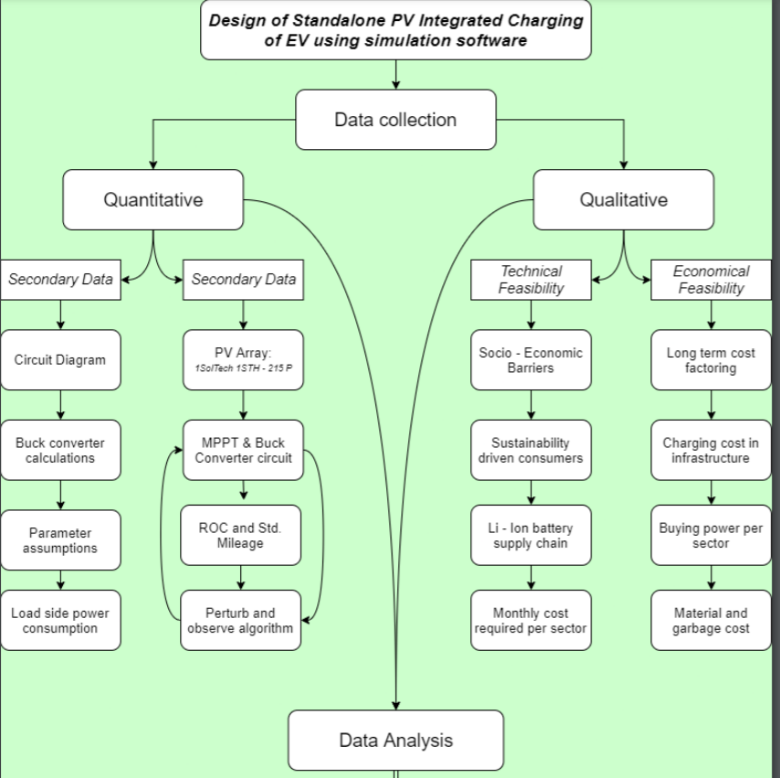
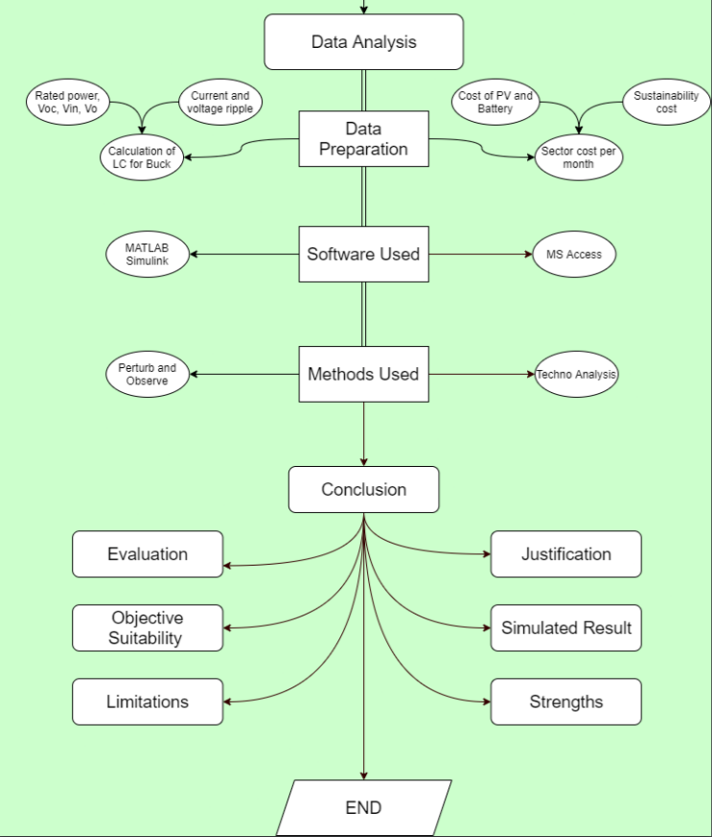
Then for the 3rd stage the code for MPPT is written in a separate MATLAB function block and is fed the input parameters (V and I) from the PV array via unit delay blocks with sample time 1e-4. Then the output of the MATLAB function block is fed to a comparator along with a repeating sequence and the combined output is fed back to the mosfet (buck converter). The output of battery charging and solar output is then finally compared.

Slide 9
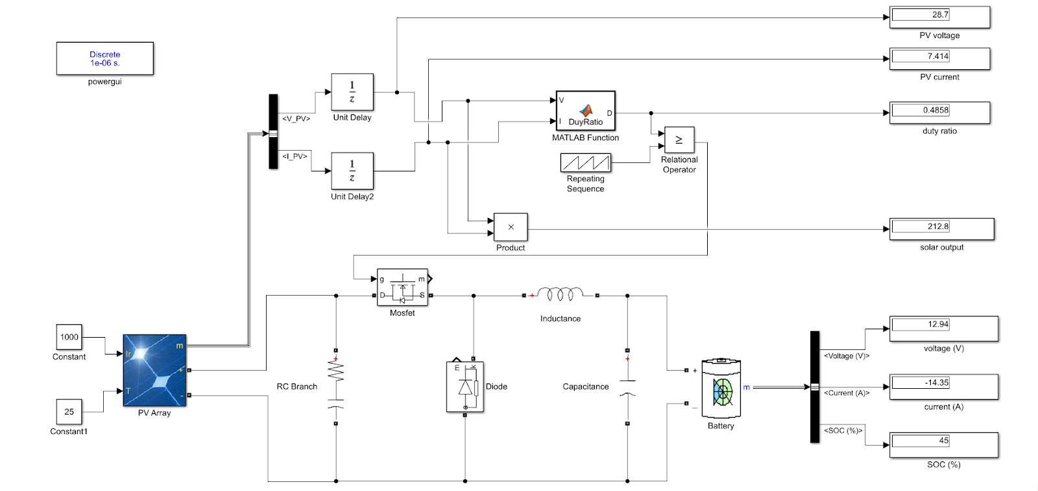
Simulation & Result

Slide 10
In our model we have incorporated a buck converter along with a MATLAB function block containing the MPPT code to harness maximum power from a PV module to charge a Li - Ion battery.
Initially the specification for the buck converter is calculated. For our project we are keeping the rated power at 210W. The range of the solar input voltage is kept between 28V to 36V. The battery output voltage is nominal of 12V - 13V with a switching frequency for the PWM generator of 5 kHz. For our project the voltage ripple is kept at 1% of the output voltage and the current ripple is kept at 1% of the output current.
Now,
Iout = Rated power/Vout = 210/12 = 17.5A ---- (1)
Iripple = 10% of Iout = 10% of 17.5A = 1.75A ---- (2)
Vripple = 1% of Vout = 1% of 12V = 0.12V ---- (3)
Filter inductance = {Vout(Vin - Vout)}/(Fsw * Iripple * Vripple)
= {12 * (28 - 12)}/(5000*1.75*0.12)
= 0.783 mH ---- (4)
Filter capacitance = Iripple/(8 * Fsw * Vripple)
= 1.75/(8 * 5000 * 0.12)
= 364 uF ---- (5)

Slide 11
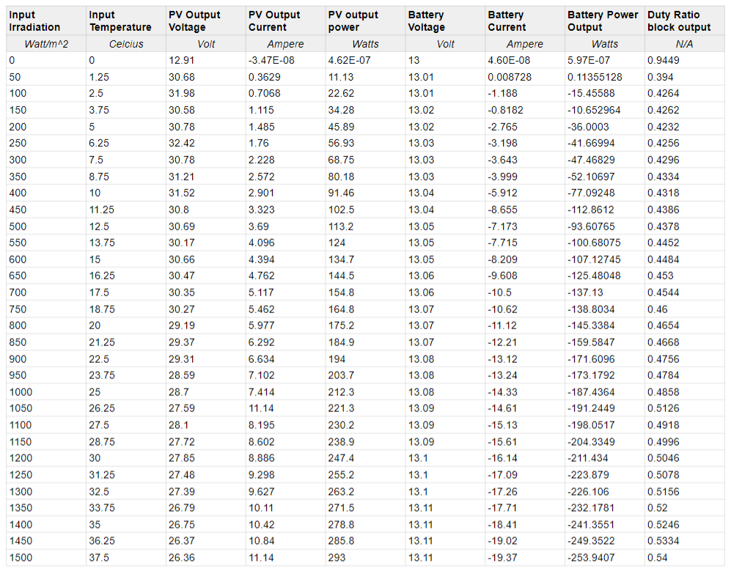

Slide 12
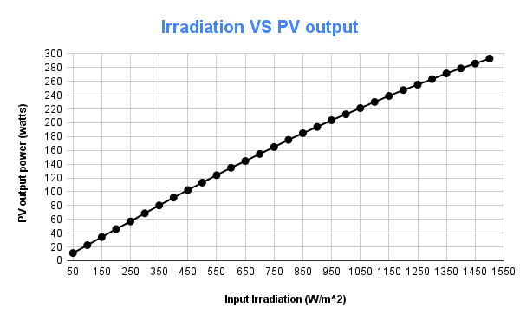
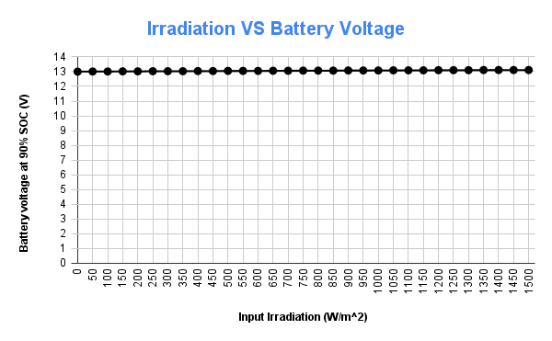
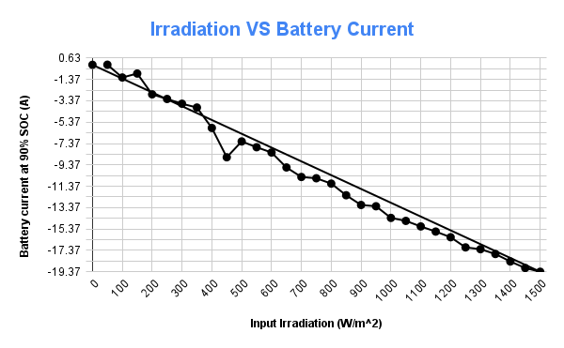
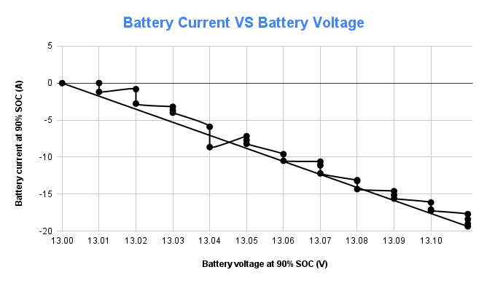
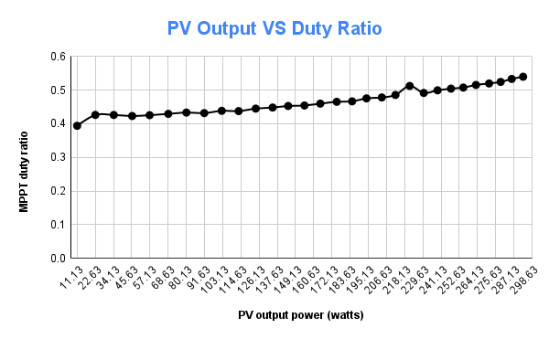
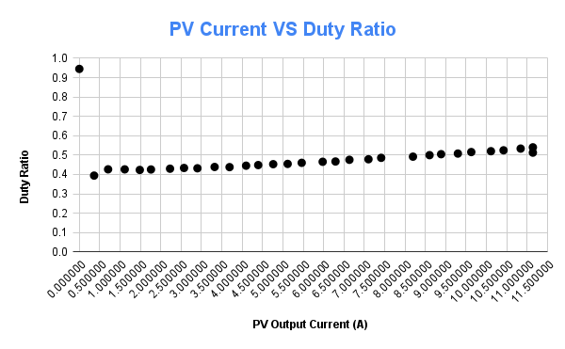
Findings Compared for 30 different data point values

Slide 13
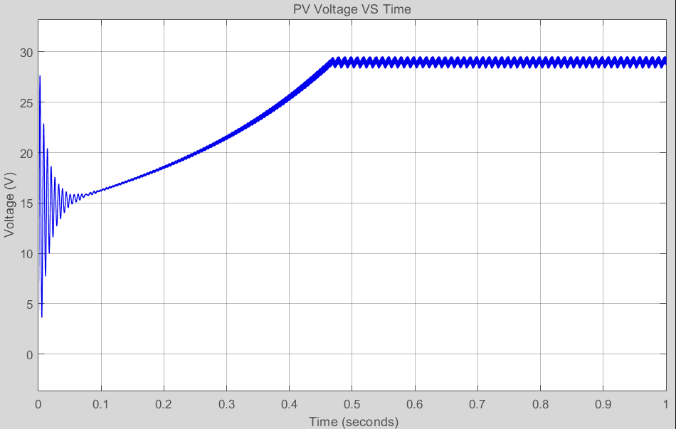
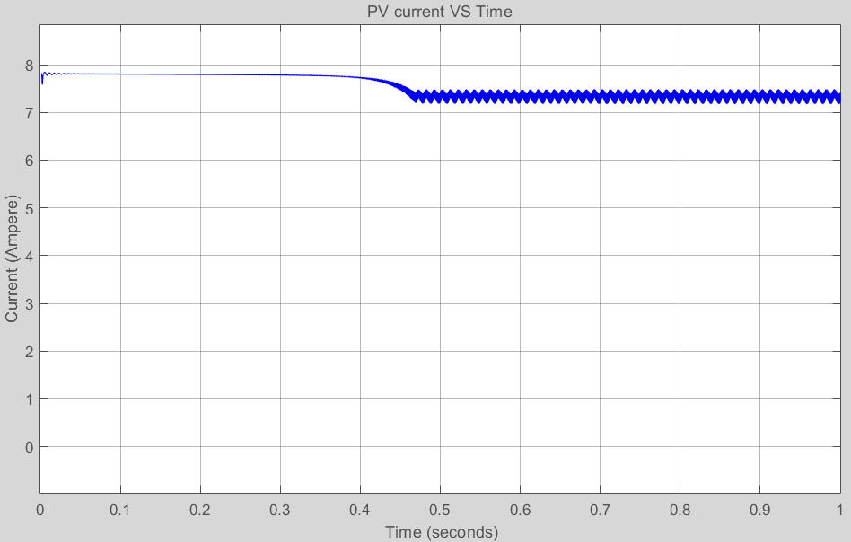
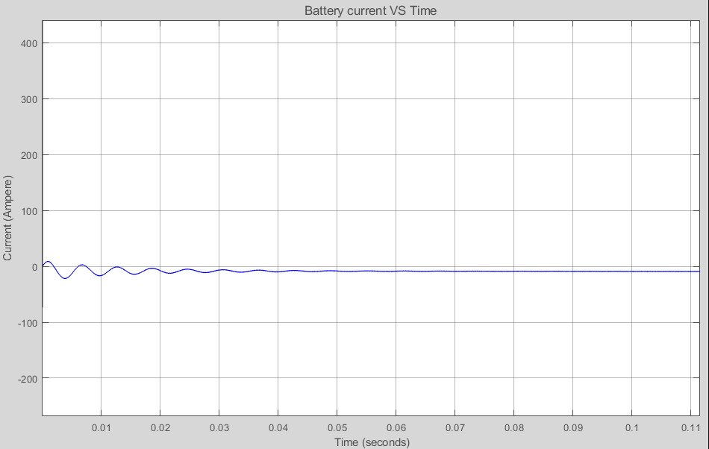
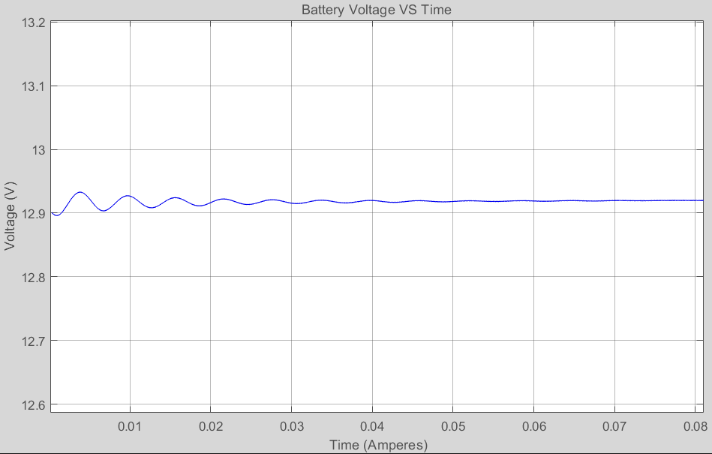
Charging Trend at 1000 irradiation/25 deg C

Slide 14
Innovation
For our project we have aimed at using Maximum Power Point Tracking to improve upon the original idea of panel tracking which added more movable parts and it therefore came at the cost of durability of the vehicle.
Panel tracking is where the panels are on a mount that follows the sun. The most common are the Zomeworks. These optimize output by following the sun across the sky for maximum sunlight. These typically give you about a 15% increase in winter and up to a 35% increase in summer but require more mechanical and movable parts. This is just the opposite of the seasonal variation for MPPT controllers. Since panel temperatures are much lower in winter, they put out more power. And winter is usually when you need the most power from your solar panels due to shorter days.
Maximum Power Point Tracking is electronic tracking - usually digital. The charge controller looks at the output of the panels and compares it to the battery voltage. It then figures out what is the best power that the panel can put out to charge the battery. It takes this and converts it to best voltage to get maximum AMPS into the battery. (Remember, it is Amps into the battery that counts). Most modern MPPT's are around 93-97% efficient in the conversion. You typically get a 20 to 45% power gain in winter and 10-15% in summer. Actual gain can vary widely depending weather, temperature, battery state of charge, and other factors.
From our literature and journal surveys we came to know that the next gen advancement for grid tie systems are becoming more popular as the price of solar drops and electric rates go up. There are several brands of grid-tie only (that is, no battery) inverters available.
All of these have built in MPPT. Efficiency is around 94% to 97% for the MPPT conversion on those.

Slide 15
Conclusion
So, finally we conclude by stating that the need for renewable resources is far more in demand today than it was ever. Therefore we need to switch towards a more sustainable source of energy i.e. Solar Energy. Hence after the completion of our project we have found that to gain or extract maximum performance out of a PV module it is necessary to incorporate certain algorithms to maximize the battery charging output. So after a comparative analysis we have found out that by using a module 1Soltech-1STH-215 P PV array rated at 25 deg C for 1000 irradiation one can charge a Li - Ion battery rated at 1.3KWh at 90% SOC with a nominal voltage at 12V - 14V.
Now that one has concluded the project it is worthwhile to mention that the approach has some limitations that one would like to mention. It must also be noted that these limitations are by no means to undermine the field of EV but to bring up the challenges one think will be faced by integrating a standalone PV integrated charging. Firstly by using a PV module the max battery capacity that can be efficiently charged is rated at 1000Ah or 12kWh whereas the current world leader at EV vehicles, Tesla has Li - Ion batteries that are rated at 13.5kWh at level 1 charging. Moreover the PV installation could add extra cost to the car and will increase the total number of movable parts installed on the car as the PV module would require to be aligned with the sun.
So, it is advisable to use this form of charging on smaller rated vehicles such as Electric Rickshaws, Electric Autos, etc i.e. vehicles that are not built for high end uses. If MPPT I to be incorporated into vehicles that demand speed appropriate Battery Management Algorithms with PWM generators must be utilized.

